Slide 1
Ansible tower
ow

Slide 2
overview
Ansible Tower is Ansible at a more enterprise level. It is a web-based solution for managing your organization with a very easy user interface that provides a dashboard with all of the state summaries of all the hosts, allows quick deployments, and monitors all configurations.
The tower allows you to share the SSH credentials without exposing them, logs all the jobs, manage inventories graphically and syncs them with a wide variety of cloud provider

Slide 3
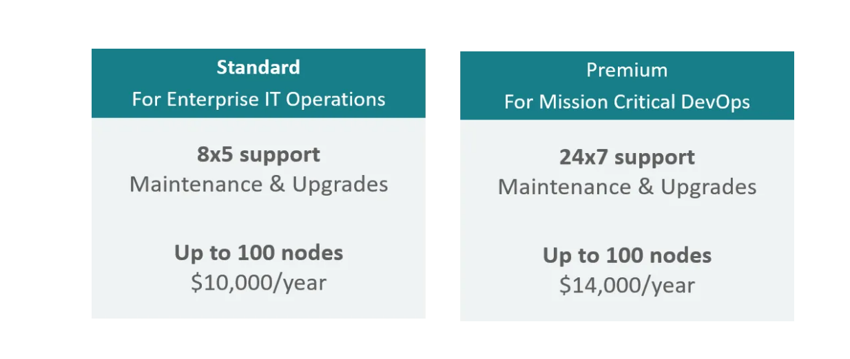
..

Slide 4
..
Multi-Playbook Workflows — This feature allows you to chain any number of playbooks, regardless of the usage of different inventories, utilizes various credentials, or runs different users.
Scale Capacity With Clusters — We can connect multiple Ansible Tower nodes into an Ansible Tower cluster as the clusters add redundancy and capacity, which allow you to scale Ansible automation across the enterprise.
Manage & Track Inventory — Ansible Tower helps you manage your entire infrastructure by letting you easily pull inventory from public cloud providers such as Amazon Web Services, Microsoft Azure, and more.

Slide 5
..
REST API & Tower CLI Tool — Every feature present in Ansible Tower is available via Ansible Tower’s REST API, which provides the ideal API for a systems management infrastructure. The Ansible Tower’s CLI tool is available for launching jobs from CI systems such as Jenkins, or when you need to integrate with other command-line tools.
Remote Command Execution — You can run simple tasks such as add users, restart any malfunctioning service, reset passwords on any host or group of hosts in the inventory with Ansible Tower’s remote command execution.

Slide 6
Download link
https://docs.ansible.com/ansible-tower/latest/html/quickinstall/download_tower.html

